Slide 1
The MetaBox
A paradoxical
approach
to Innovation
Ken Mulligan ©
Presented At Chalmers University Gothenburg, Sweden
June 4th, 2019
Notes:
Good – it almost look it is floating in thin air

Slide 2
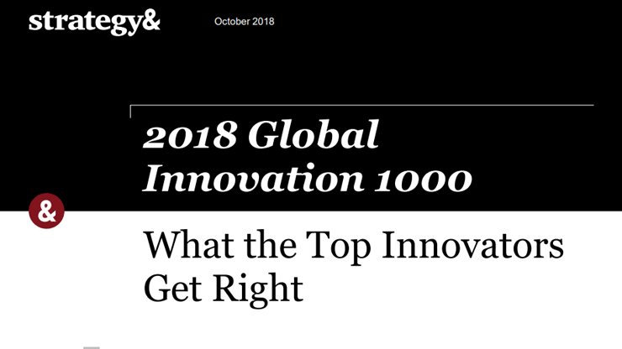
The Most Innovative Companies Our Perform Their Competition
The 2018 PWC Global Innovation 1000 Study Found:
Sales Growth Was 2.6 X Greater Than Their Competition
Operating Income Was 2.5X That Of The Average Company In The Study.

Slide 3
“Science is imagination in a straightjacket!”
– Richard Feynman
https://www.bbc.co.uk/programmes/b0b0pwgl
Notes:
Clever quote

Slide 4
Curiosity
Curiosity Is The Engine Of Achievement
Photo: Creative Commons / Chaser
Notes:
Good….Chris Skiba constructed the steering if I’m correct

Slide 5
The Structure of Scientific Revolutions
Notes:
Does it or is science composed of problems solved

Slide 6
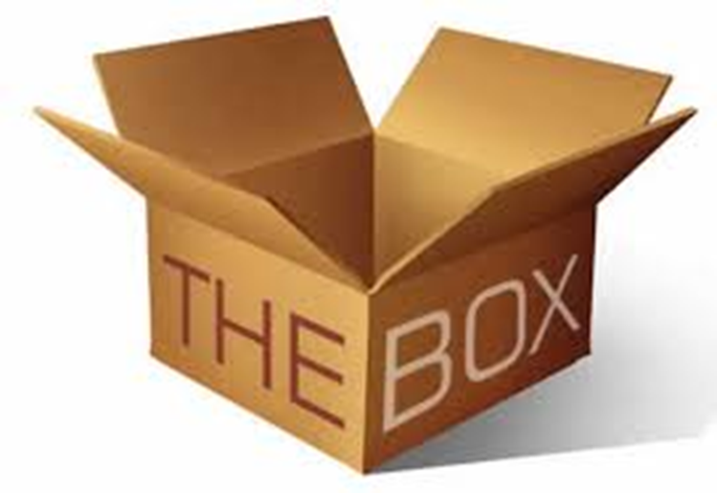
The Box – A Metaphoric Container Of Your Current Assumptions and Habitual Patterns of Thinking
Enforces Standard Operational Procedures (SOP)

Slide 7
Where Do Big Ideas Come From?
Here?
Or Here?

Slide 8
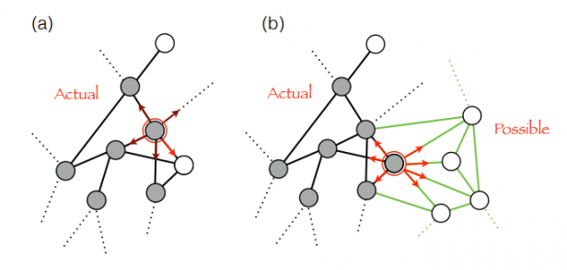
Patterns and Innovation --- Exploiting Patterns
At The Core Of Innovation
Is The Formation And Exploitation of Patterns.
https://www.technologyreview.com/s/603366/mathematical-model-reveals-the-patterns-of-how-innovations-arise/
Notes:
Like this one a lot

Slide 9
Patterns and Innovation --- It’s All About Noticing
It Begins With Noticing Patterns We Were Previously Blind To!
…And Rethinking Objects and Solutions To Discover New Opportunities
Notes:
Like this one a lot

Slide 10
Patterns and Innovation --- Pattern Disruption
Thinking Out Of The Box Is All About Pattern Disruption!
https://knowledge.wharton.upenn.edu/
Notes:
Like this one a lot

Slide 11
MetaBoxical Thinking --- Thinking Outside The Box
A Form Of Lateral Thinking That Involves Letting Go Of An Unsuccessful Attempt To Solve A Problem By Changing The Sequence Of Steps Or Simply Leap Frogging Sequential Thinking All Together

Slide 12
What’s In Your Box?

Slide 13
What’s Outside Your Box?

Slide 14
What’s Outside Of What You Can Even Imagine?
“Unknown” Unknowns

Slide 15
“The way we think defines the BOX in which we find ourselves.”

Slide 16
“The Box Contains Patterns Which Enable Us To Create And Maintain Standards By Ensuring Sameness”

Slide 17
“Which Allows The Achievement Of Consistently High Quality Products”

Slide 18
“Successful Enterprises Usually Focus On Becoming Increasingly Efficient In Replicating These Same Basic Things”

Slide 19
So What’s Wrong With The Box?

Slide 20
The Very Thing That Makes The Box Successful Limits Its Innovations To Incremental Changes

Slide 21
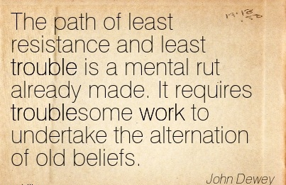

Slide 22
What Patterns of Thinking Can Release New Ideas?
Notes:
Profound!

Slide 23
https://juandomingofarnos.wordpress.com/
Notes:
Use a picture or only the picture above removing all text around it

Slide 24
Explore Adjacent Possibilities
“The strange and beautiful truth about the adjacent possible is that its boundaries grow as one explores them.” - Steven Johnson “Where Good Ideas Come From”

Slide 25
Novelty emerges through the interaction of the “actual” with the “possible.” The design process puts a functional structure in place to bring into existence these emergent novelties as innovations and inventions."
https://pixabay.com/images/search/gear-wheel/
Notes:
Important messages but hard to read since background is so complicated….

Slide 26
Start By Challenging The Orthodoxies
http://www.ideachampions.com/weblogs/archives/2015/05/index.shtml

Slide 27
Engage In Patterns Of Thinking That Produce Innovation!
© Rowan Gibson Four Lenses of Innovation

Slide 28
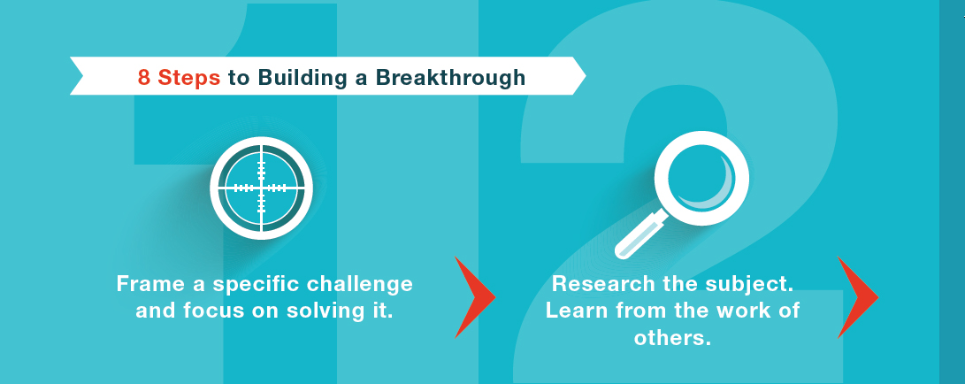
8 Steps To Building A Breakthrough
© Rowan Gibson Four Lenses of Innovation

Slide 29
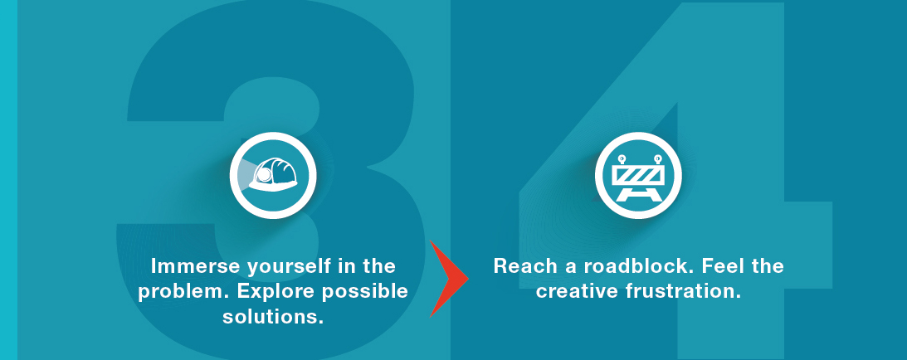
8 Steps To Building A Breakthrough
© Rowan Gibson Four Lenses of Innovation

Slide 30
8 Steps To Building A Breakthrough
© Rowan Gibson Four Lenses of Innovation

Slide 31
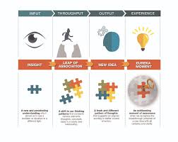
Develop Insights
Insights Are The Triggers That Can Lead To A New Idea!
© Rowan Gibson Four Lenses of Innovation

Slide 32
Insights Are The Raw Material For Building Big Ideas
“A New And Penetrating Understanding That Allows Us To See A Problem From A new Perspective”

Slide 33
8 Steps To Building A Breakthrough
© Rowan Gibson Four Lenses of Innovation

Slide 34
Let’s Look At A Familiar Object You Use Everyday
Functional Fixedness
How Might You Make It Better or Different?
What Else Could You Use This For?
Notes:
Different usage?

Slide 35
“Normal Science is Puzzle Solving Within a Paradigm”
https://www.template.net/category/design-templates/print/

Slide 36
Ken Mulligan teaches Technology Entrepreneurship, Entrepreneurial Mindset and Strategic Enterprise Innovation in the Ira A. Fulton Schools of Engineering at Arizona State University. He is an advisor to several startups focused on Regenerative Medicine, Cyber Security and Blockchain.
He can often be found in a remote stream fly fishing for trout
Email: Kenneth.mulligan@asu.edu
Website: www.kenofzen.com

